Slide 1
Components for an E-Commerce website
These are the things you would need if you were considering building an ecommerce site from scratch

Slide 2
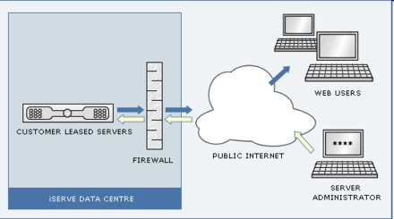
Server …

Slide 3
Server …
Somewhere there needs to be a server connected to the internet that hosts your website

Slide 4
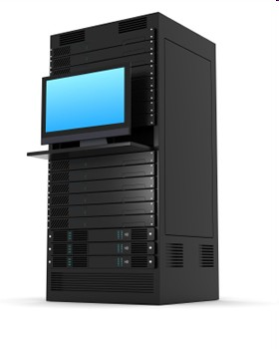
(Cyber)Space
The server must have enough space to host your site (including images, videos, music)

Slide 5
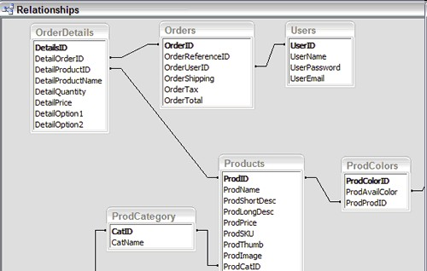
Database
The server must support databases

Slide 6
Database
The server must support databases

Slide 7
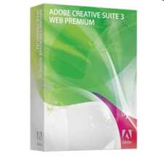

Software
The people creating the webpage will also need webauthoring software

Slide 8

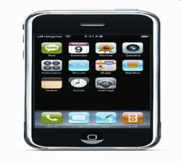

Software
They will also need to check that the website works on different platforms

